Slide 1
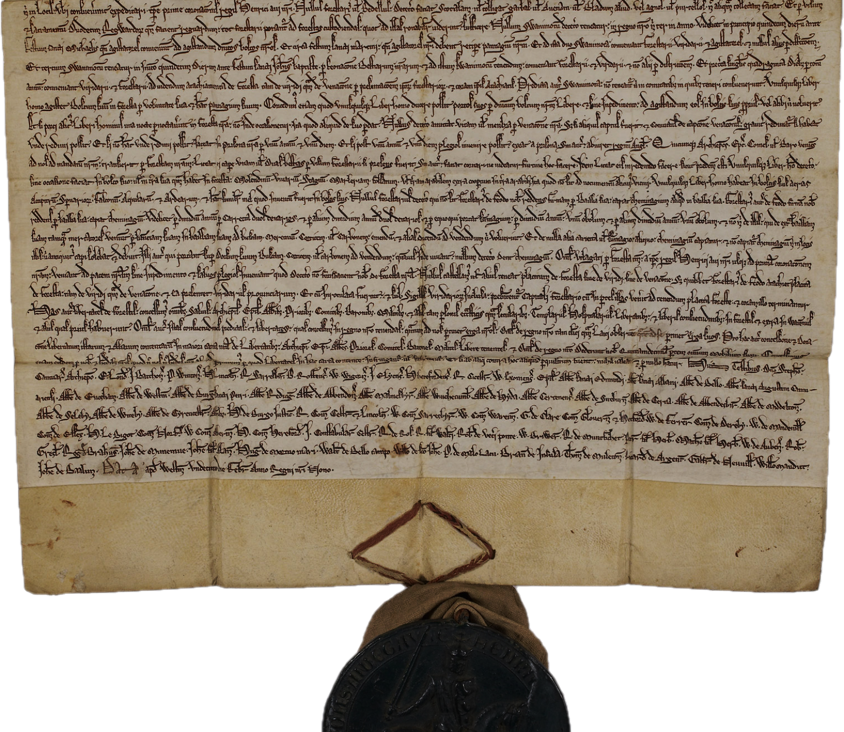
Follow the Patents… …It will take you to the money
Dr. David E. Martin
www.davidmartin.world

Slide 2
This MANDATORY INJECTION was planned in 2015 by the COVID RICO CONSPIRATORS
“…until an infectious disease crisis is very real, present, and at an emergency threshold, it is often largely ignored. To sustain the funding base beyond the crisis, he said, we need to increase public understanding of the need for MCMs such as a pan-influenza or pan-coronavirus vaccine. A key driver is the media, and the economics follow the hype. We need to use that hype to our advantage to get to the real issues. Investors will respond if they see profit at the end of process, Daszak stated.”
2016 Feb 12. 6, Developing MCMs for Coronaviruses. Available from: https://www.ncbi.nlm.nih.gov/books/NBK349040/

Slide 3
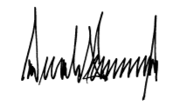
In recognition of these limitations, the President signed the Executive Order on Modernizing Influenza Vaccines in the United States to Promote National Security and Public Health on September 19, 2019. Broadly, the Executive Order directs BARDA, CDC, NIH, and FDA to accelerate the adoption of improved influenza vaccine technologies. In alignment with the goals of the Executive Order, NIAID is conducting and supporting research to develop state-of-the-art vaccine platform technologies that could be used to develop universal influenza vaccines as well as to improve the speed and agility of the influenza vaccine manufacturing process. These platform technologies include DNA, messenger RNA (mRNA), virus-like 5 particles, vector-based, and self-assembling nanoparticle vaccines. For example, NIAID supported scientists are investigating an mRNA vaccine candidate that would allow for a more rapid and flexible response to both seasonal and pandemic influenza than do existing vaccine production strategies.
https://energycommerce.house.gov/sites/democrats.energycommerce.house.gov/files/documents/Testimony%20-%20Fauci%20%28NIH%29%2012.04.2019.pdf

Slide 4
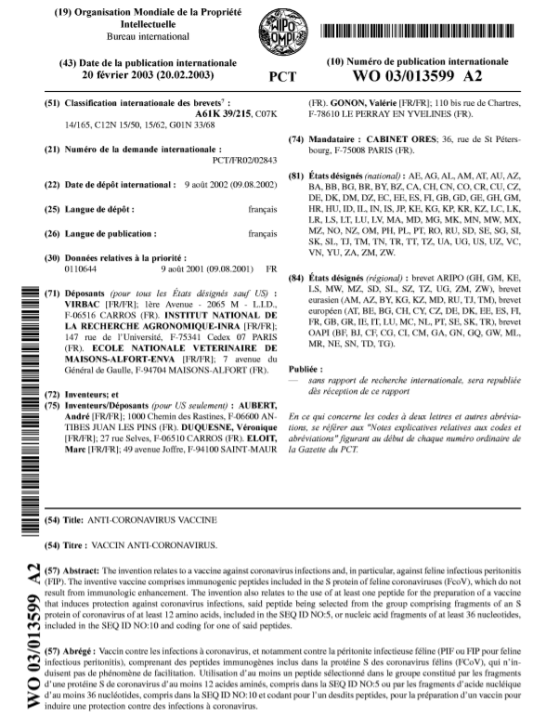
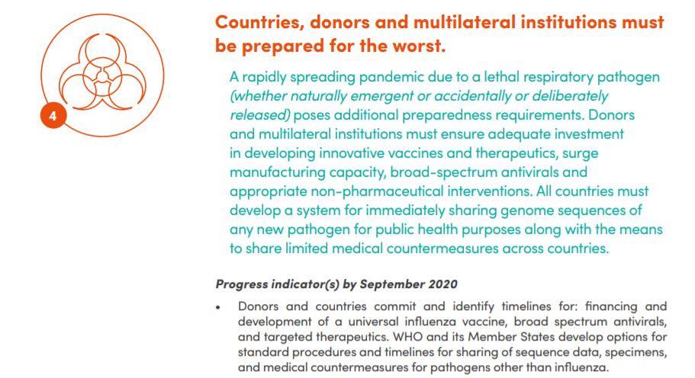
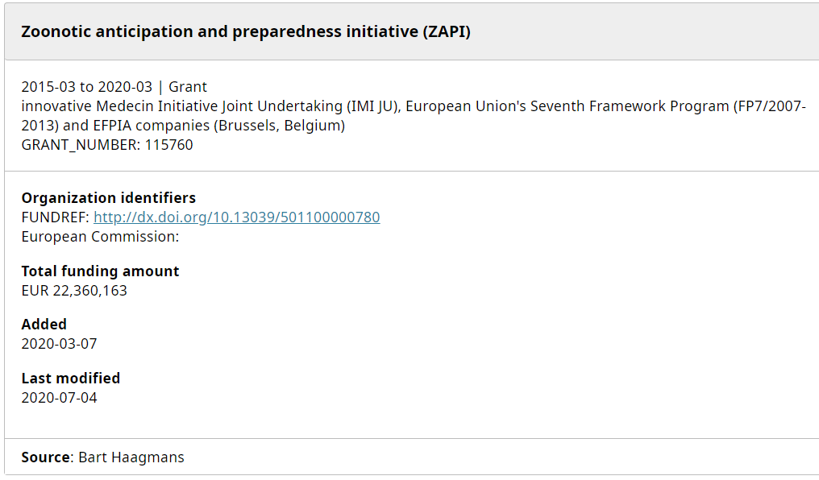
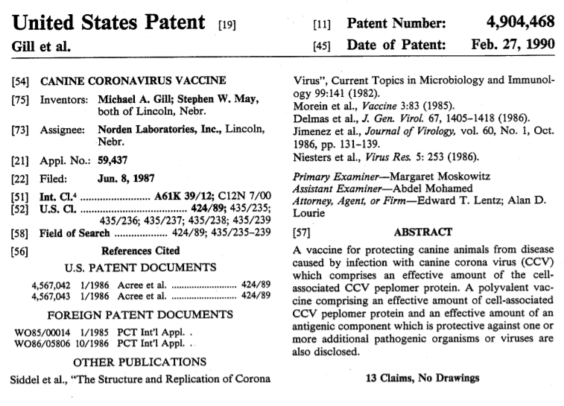
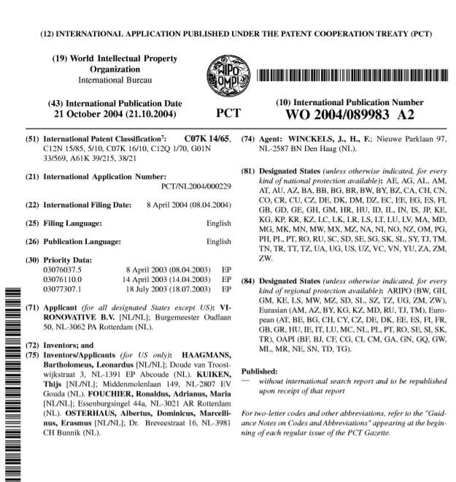
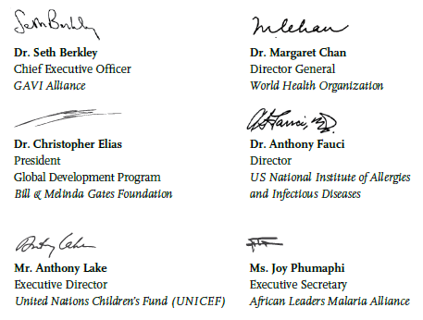
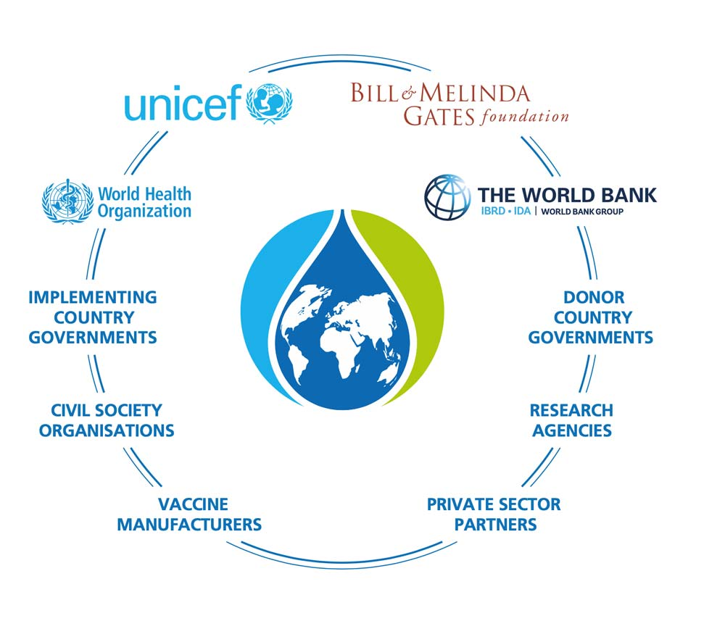
The COVID World at VAX

Slide 5
The COVID Privateers
Operation Warp Speed
armaments, biotechnology, electromagnetic spectrum, space technologies, advanced materials, shipbuilding
Vaccine Marketing
Gotham Data Tracking
HHS IT
Pfizer
Moderna
Johnson&Johnson
Merck Ridgeback
Gilead Sciences

Slide 6
The COVID Pirates
UNC Chapel Hill
Ralph Baric’s Chimera Lab
Vanderbilt
Emory
Johns Hopkins
University of California System
MIT
NYU Langone
DZIF
Prof. Dr. Christian Drosten
Imperial College
IHME
Erasmus MC
Dr. B.L. Haagmans

Slide 7
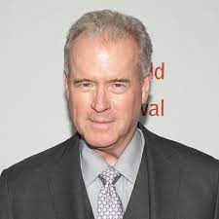
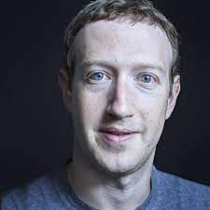
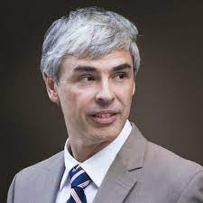
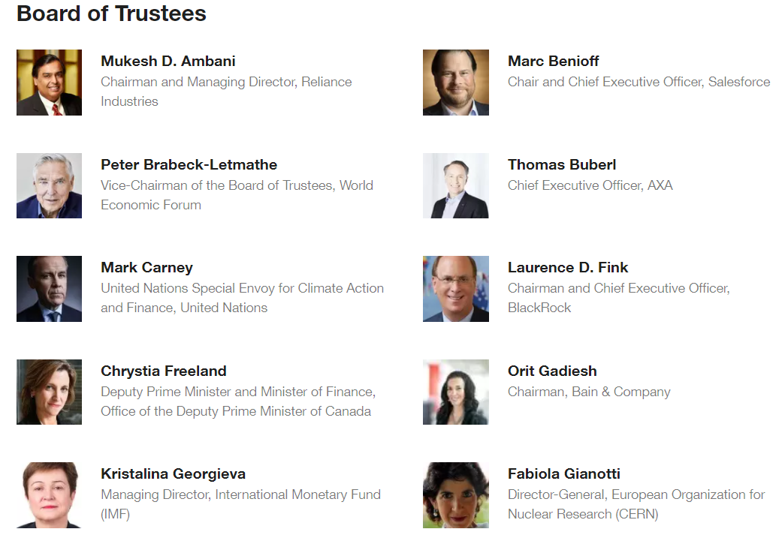
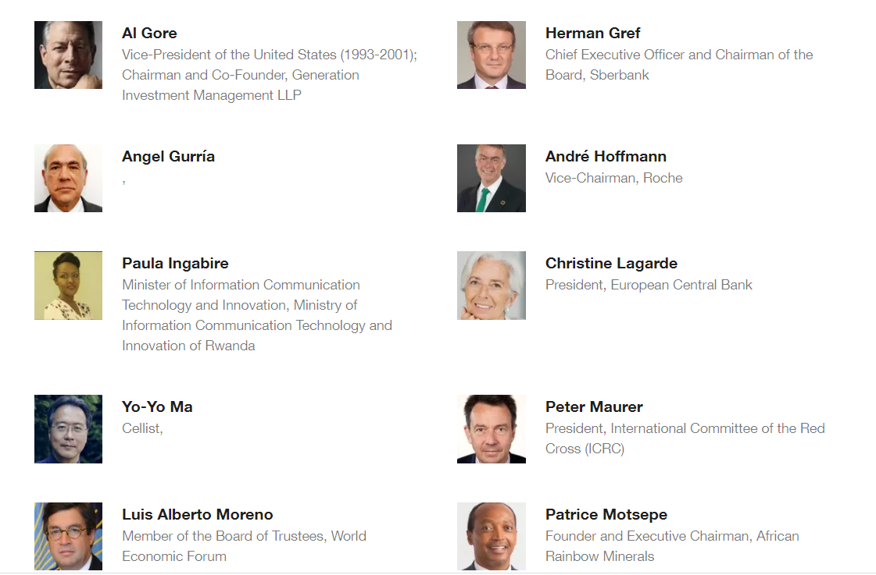
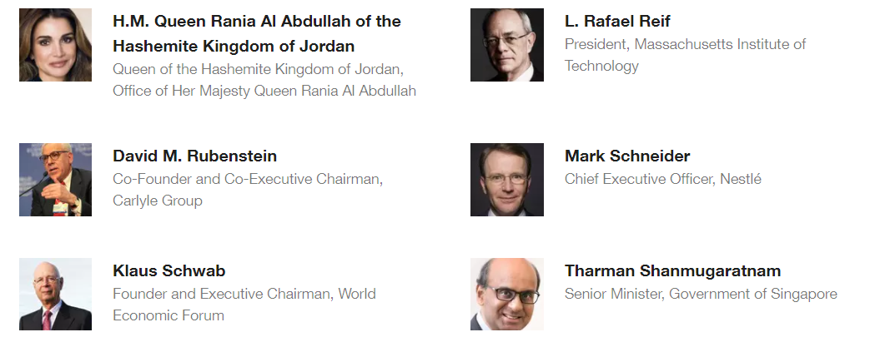
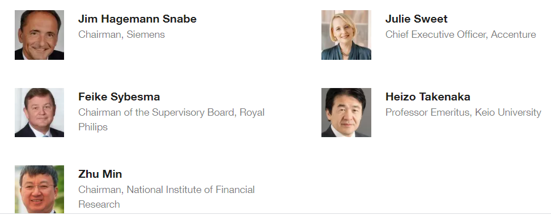
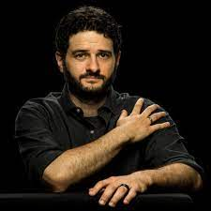
The COVID Orchestra
Robert Mercer
Renaissance Fund
Mark Zuckerberg
Facebook
Larry Page
Google
Bill Gates
Bill & Melinda Gates Foundation
OECD
Dustin Moskovitz
Open Philanthropy

Slide 8
The COVID Conspiring States

Slide 9
The COVID Treasonous Acts
CRIMINAL
18 U.S.C. §2339 C et seq. – funding and conspiring acts of terror
18 U.S.C. § 2331 §§ 802 – acts of domestic terrorism resulting in death of American Citizens
18 U.S.C. § 1001 – lying to Congress
15 U.S.C. §1-3 – conspiring to criminal commercial activity
15 U.S.C. §8 – market manipulation and allocation
15 U.S.C. § 19 – interlocking directorates
CIVIL
35 U.S.C. §206 – disclosure of government interest
35 U.S.C. §101 – patenting nature
21 C.F.R. § 50.24 et seq., it is unlawful to conduct medical research (even in the case of emergency) without an independent institutional review board approved protocol including informed consent free of coercion.
15 U.S.C. §45 §§5(a) “unfair or deceptive acts or practices in or affecting commerce.”

Slide 10
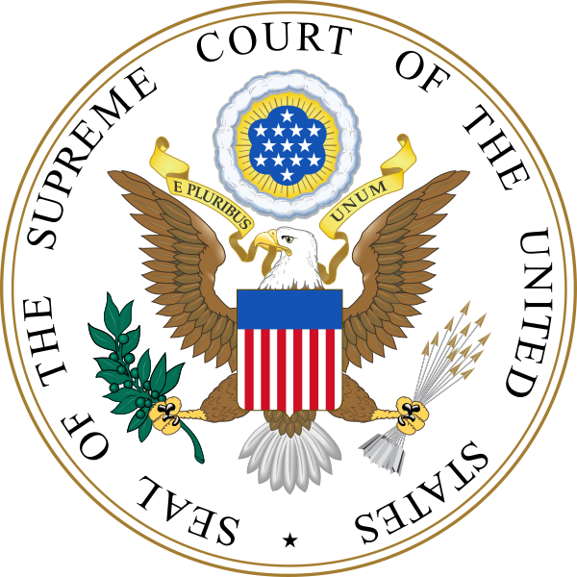
Emergency does not create power. Emergency does not increase granted power or remove or diminish the restrictions imposed upon power granted or reserved. The Constitution was adopted in a period of grave emergency. Its grants of power to the Federal Government and its limitations of the power of the States were determined in the light of emergency, and they are not altered by emergency. What power was thus granted and what limitations were thus imposed are questions which have always been, and always will be, the subject of close examination under our constitutional system. While emergency does not create power, emergency may furnish the occasion for the exercise of power.
Home Building & Loan Ass’n v. Blaisdell, 290 U.S. 398, 425-426 (1934).

Slide 11
The COVID “Intolerable Acts”
While Congress didn’t restrict speech, assembly, or right to petition, it made no effort to uphold and defend these rights. Further, it stood by as these rights were abused by every Emergency Declaration in violation of Supreme Court rulings. By allowing Federal Contractors to disregard the Constitution, they’ve violated this Amendment.
Amendment I
Congress shall make no law respecting an establishment of religion, or prohibiting the free exercise thereof; or abridging the freedom of speech, or of the press; or the right of the people peaceably to assemble, and to petition the Government for a redress of grievances.

Slide 12
The COVID “Intolerable Acts”
By declaring every person a probable “asymptomatic carrier” the Federal Government (CDC, FDA, and DHHS) violated this Amendment and enabled the reckless abuse that harmed countless individuals. Loss of life, liberty and livelihood has been a DIRECT result.
Amendment IV
The right of the people to be secure in their persons, houses, papers, and effects, against unreasonable searches and seizures, shall not be violated, and no Warrants shall issue, but upon probable cause, supported by Oath or affirmation, and particularly describing the place to be searched, and the persons or things to be seized.

Slide 13
The COVID “Intolerable Acts”
Amendment V
nor shall be compelled in any criminal case to be a witness against himself, nor be deprived of life, liberty, or property, without due process of law; nor shall private property be taken for public use, without just compensation.
There has been no due process as the Courts have unilaterally stipulated the “epidemic” or “pandemic” without a single effort to demonstrate, beyond reasonable doubt, that there is either. Further, while changing the definition of “vaccine” to include “gene therapy”, the courts have inappropriately applied Jacobson

Slide 14
The COVID “Intolerable Acts”
Amendment VI
In all criminal prosecutions, the accused shall enjoy the right to a speedy and public trial, by an impartial jury of the State and district wherein the crime shall have been committed, which district shall have been previously ascertained by law, and to be informed of the nature and cause of the accusation; to be confronted with the witnesses against him; to have compulsory process for obtaining witnesses in his favor, and to have the Assistance of Counsel for his defence.
No judicial standard has been applied to validate the false claims of SARS CoV-2 “causing” COVID-19. Therefore, every derivative prosecution is in violation of the Sixth Amendment. No court has been willing to sit and consider the voluminous evidence of anti-trust, coercion and domestic terrorism, and racketeering charges against FDA, CDC, NIAID, Moderna, Pfizer, Johnson&Johnson, and their accomplices

Slide 15
The COVID “Intolerable Acts”
Amendment X
The powers not delegated to the United States by the Constitution, nor prohibited by it to the States, are reserved to the States respectively, or to the people.
The final clause in the Tenth Amendment “or to the people” has been supplanted by States assuming police powers without limit. This tyranny effectively nullifies all Constitutional protections.

Slide 16
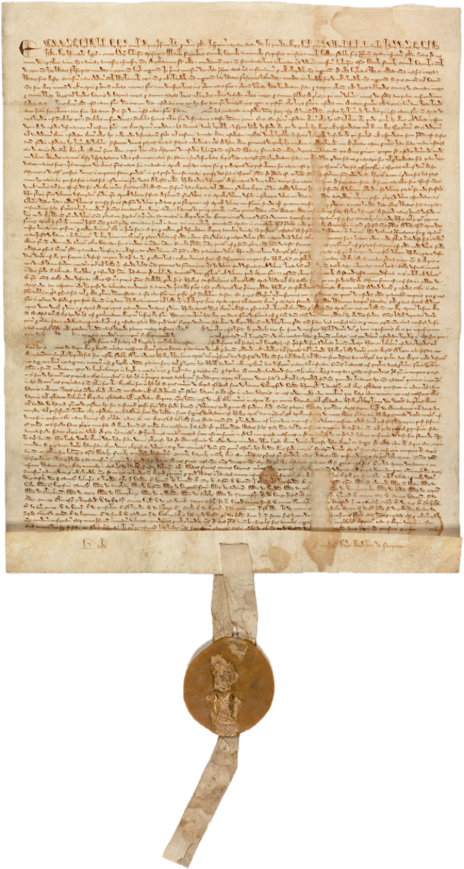
Magna Carta – 1215
Right to due process, consent, and protection from deprivations of life, liberty, and livelihood
Served as the basis for the Fifth Amendment to the U.S. Constitution
No person shall be held to answer for a capital, or otherwise infamous crime, unless on a presentment or indictment of a Grand Jury, except in cases arising in the land or naval forces, or in the Militia, when in actual service in time of War or public danger; nor shall any person be subject for the same offence to be twice put in jeopardy of life or limb; nor shall be compelled in any criminal case to be a witness against himself, nor be deprived of life, liberty, or property, without due process of law; nor shall private property be taken for public use, without just compensation.

Slide 17
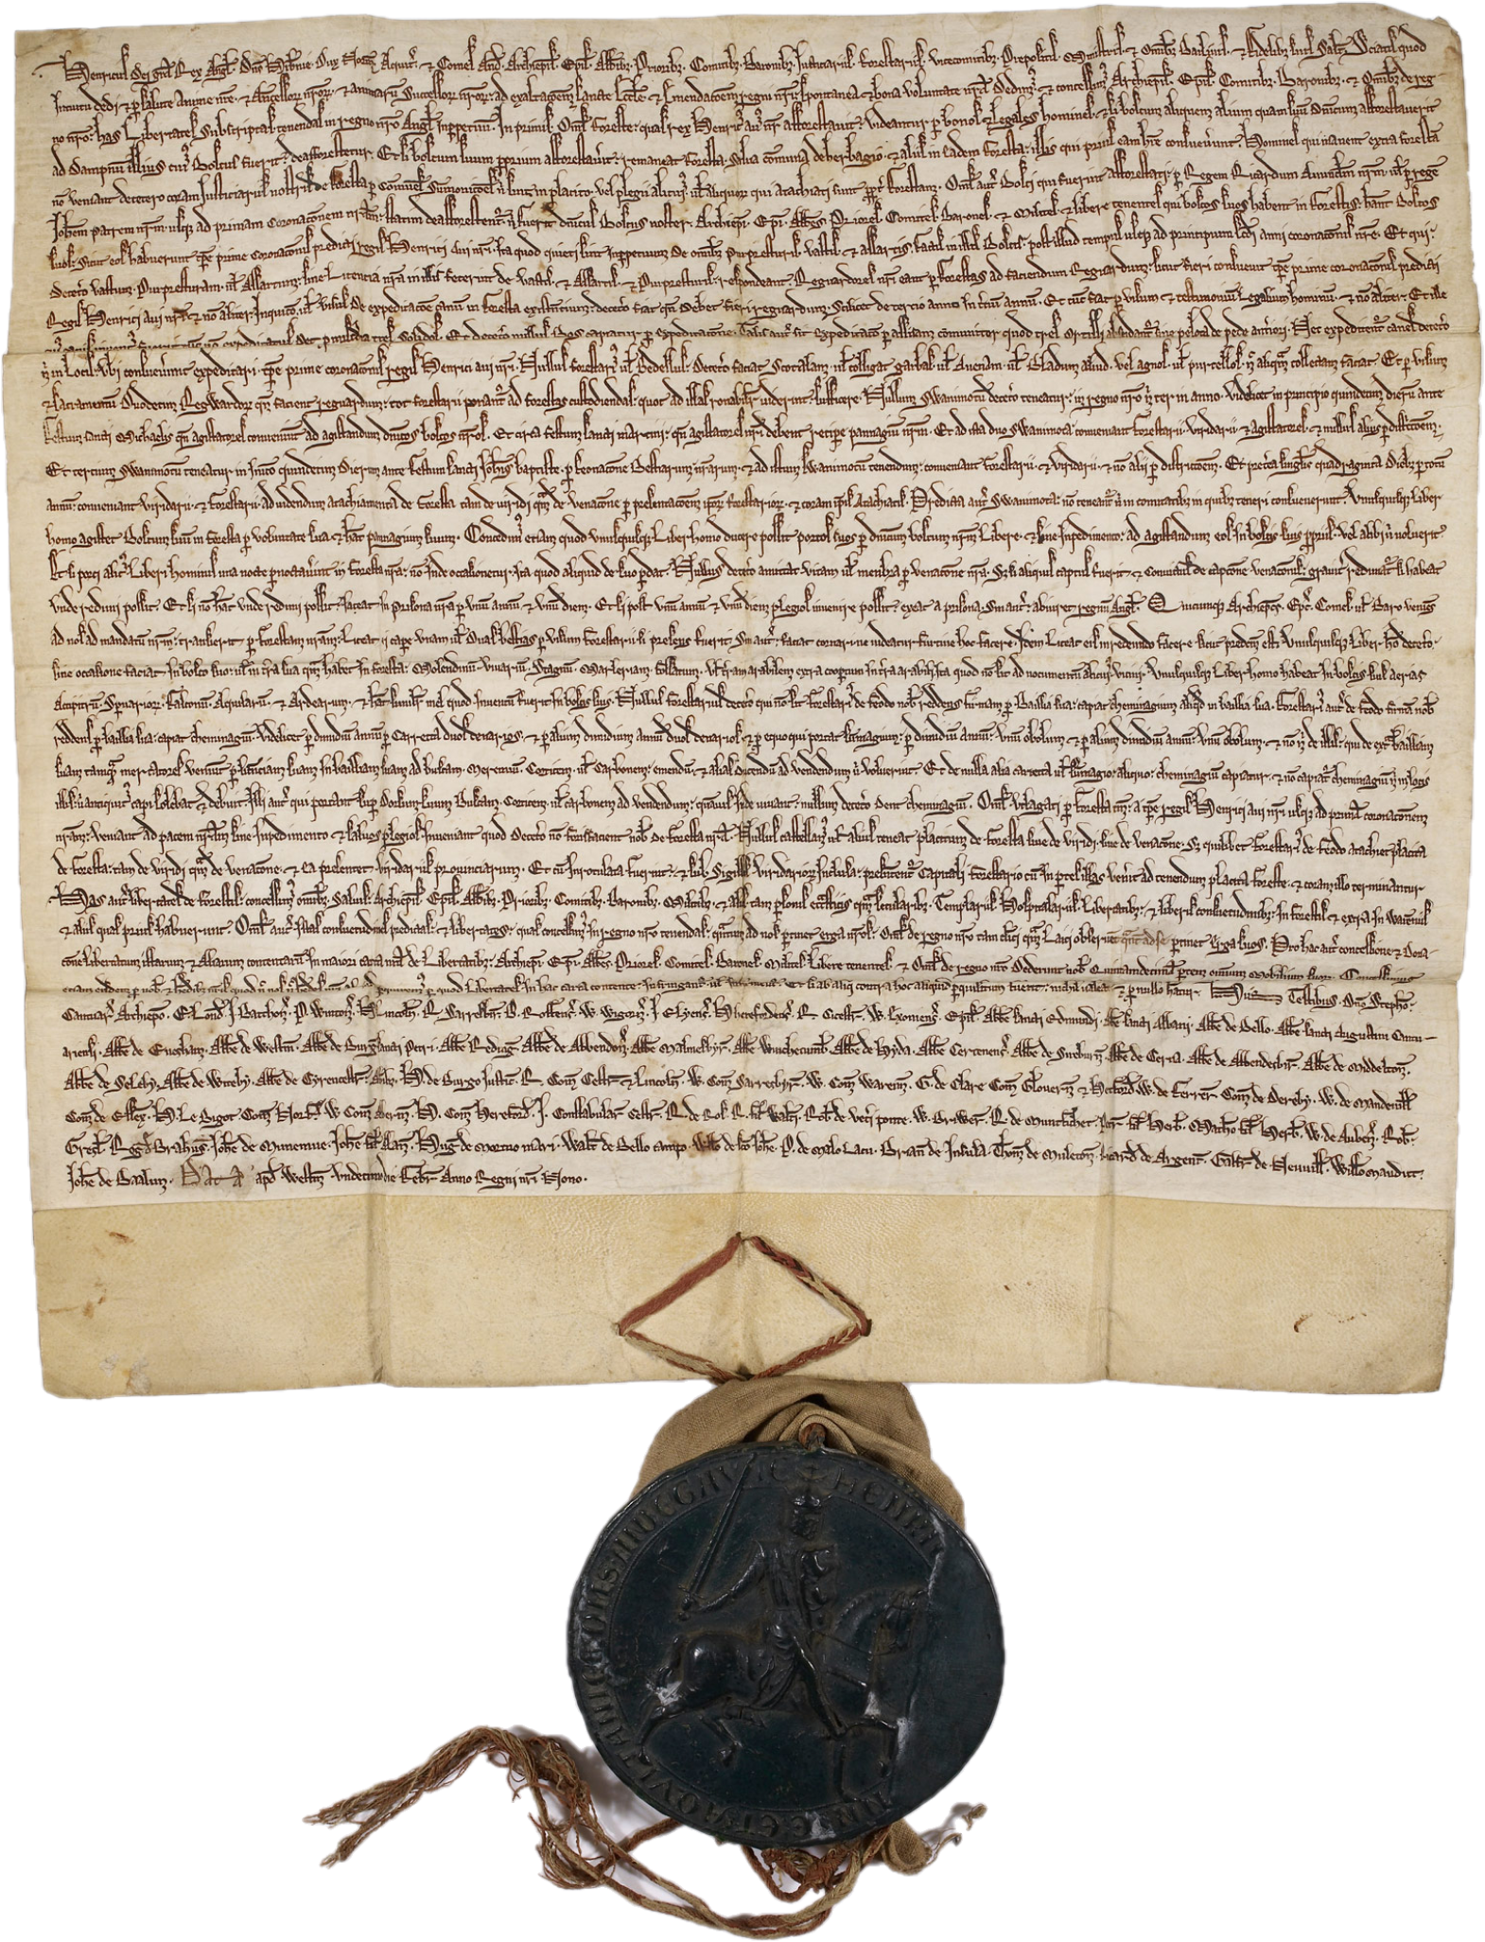
The Charter of the Forest - 1217
Recognized the rights of people to have:
Due process (Ch. 8)
Liberty of movement (Ch. 9)
Liberty of shelter (Ch. 2)
Liberty of livelihood & commerce (Ch. 12)
Amended in 1225 to include a 15% flat tax

Slide 18
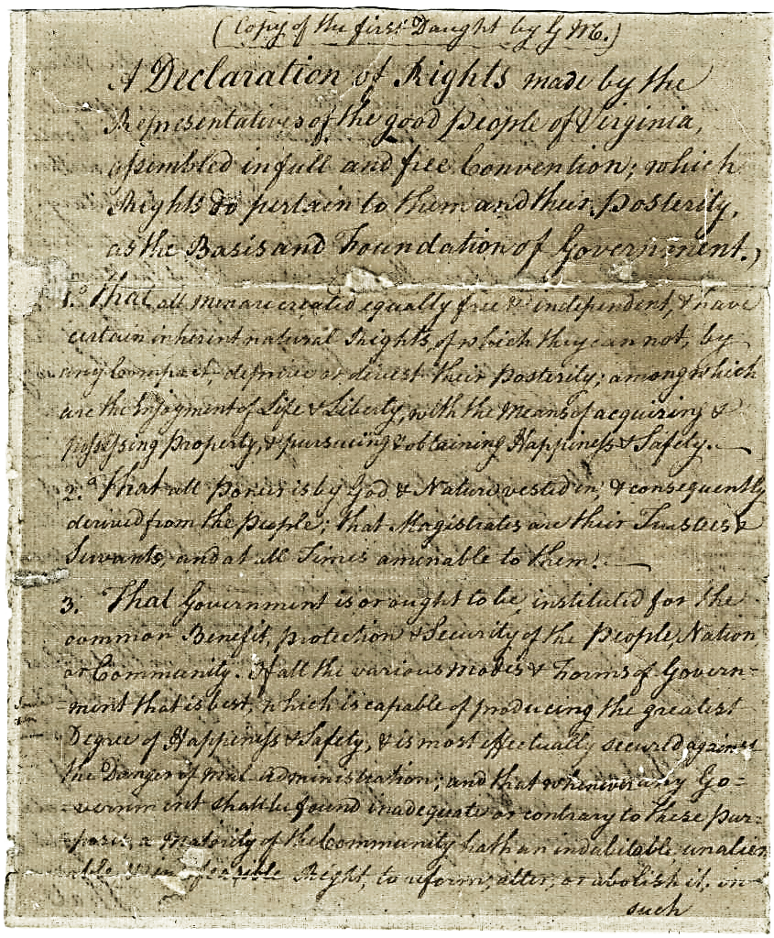
Virginia Declaration of Rights -1776
"That all Men are born equally free and independant, and have certain inherent natural Rights, of which they can not by any Compact, deprive or divest their Posterity; among which are the Enjoyment of Life and Liberty, with the Means of acquiring and possessing Property, and pursueing and obtaining Happiness and Safety.”

Slide 19
The Integral Cure… what “We The People” Means
Our Inalienable Condition
By nature, provisioned for life, liberty and livelihood unrestricted from provisioning
At liberty to peacefully assemble, speak, disagree, express, believe, choose
Freedom of Inquiry with assurance of veracity and provenance
At liberty to exchange value and commerce with transparency
Afforded access to all derivatives of public goods
Organically undefiled from birth to death

Slide 20
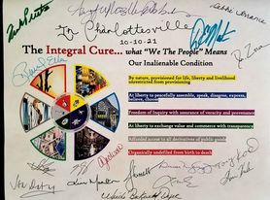
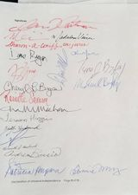
The Continental Conventions Begin…
https://www.covidcon21.com/index.php/declaration-of-universal-independence/

